Slide 1
2020-12-02
COVID-19’s Impact on TRAVEL PATTERNS
AND MODE CHOICE
North Carolina modelers user group
JORGE A. BARRIOS + MIKE ARONSON

Slide 2
What the data tells us about travel in NC

Slide 3
Pandemic Travel Trends COVID-19 Average Weekly Change in Travel in NC so far in 2020
March
April
May
June
July
August
September
October
Source: Kerry Morrow, North Carolina DOT

Slide 4
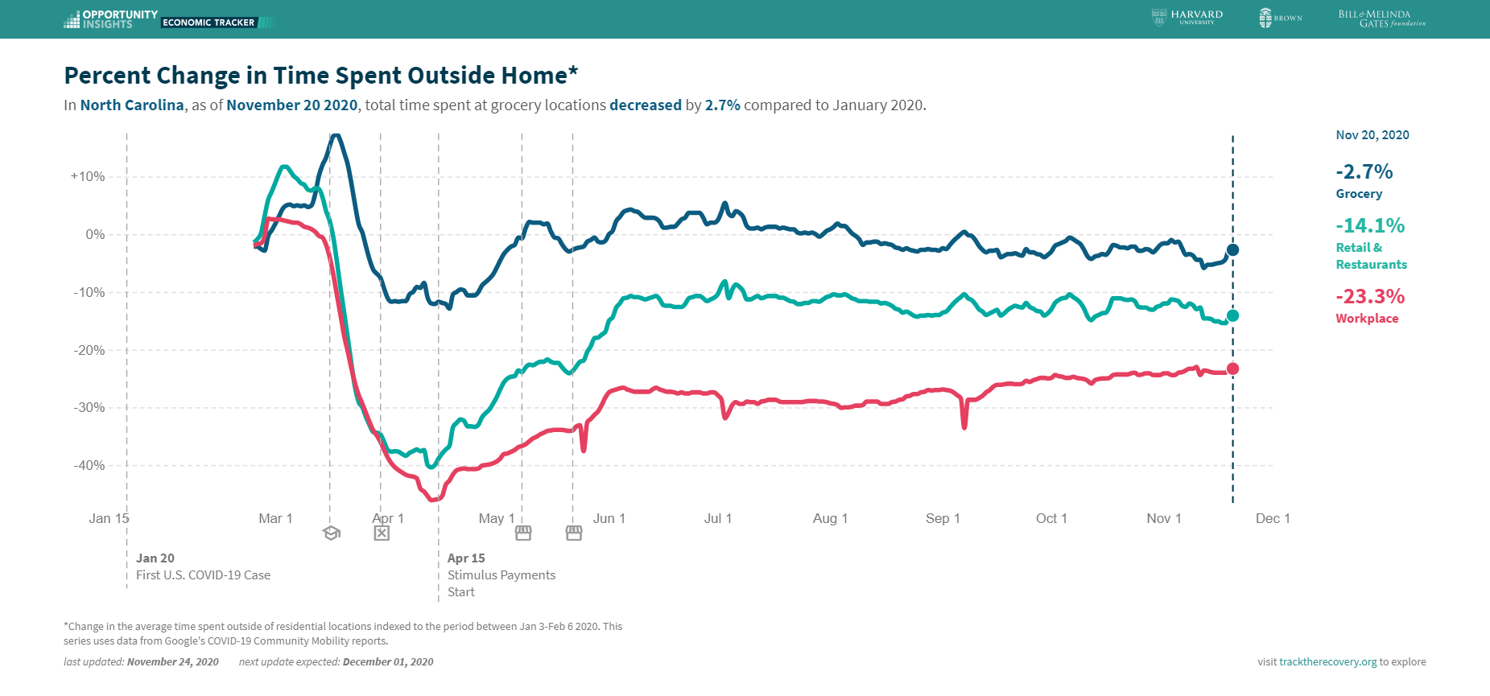

Slide 7
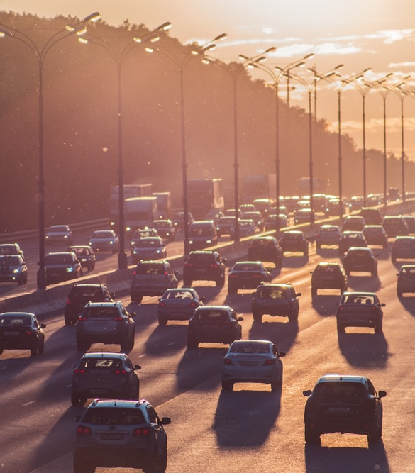
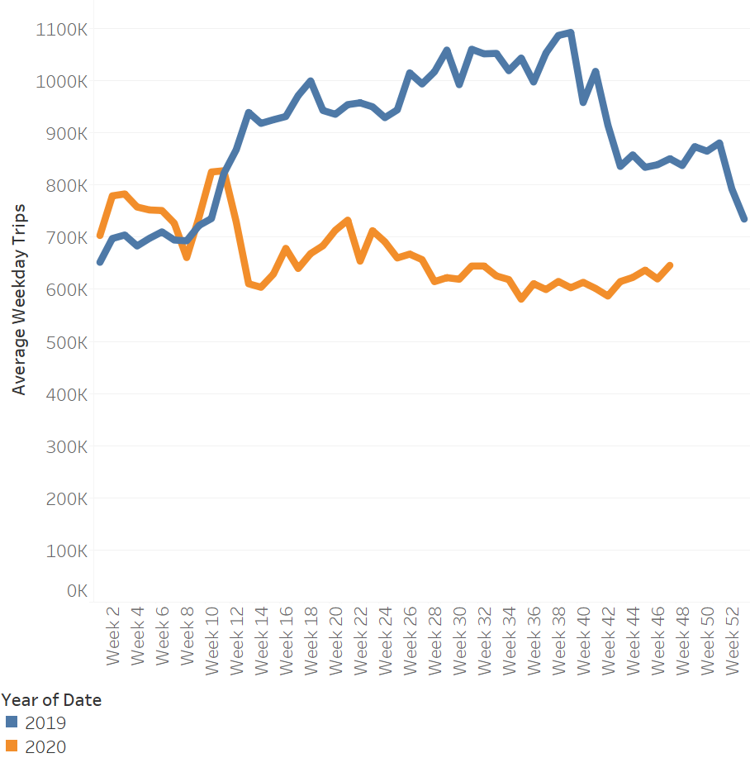
Trips per Weekday in NC
-25%

Slide 8
NC Transit Ridership (7 Largest Metros)
-43%
-50%
-44%

Slide 9
What may happen next

Slide 16
Considerations for long-range forecasting

Slide 17
Forecasting Issues
Temporary or permanent changes?
Changes in “inputs”:
Land use
Changes in behavior:
Trip generation
Mode choice
What would we change in our models ?
Scenario planning

Slide 18
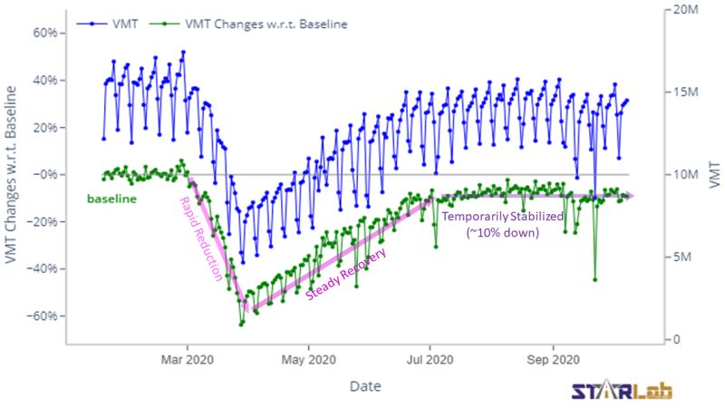
Temporary or Permanent? Vehicle travel back to within ~10% Transit and ridesharing not back from significant drops

Slide 19
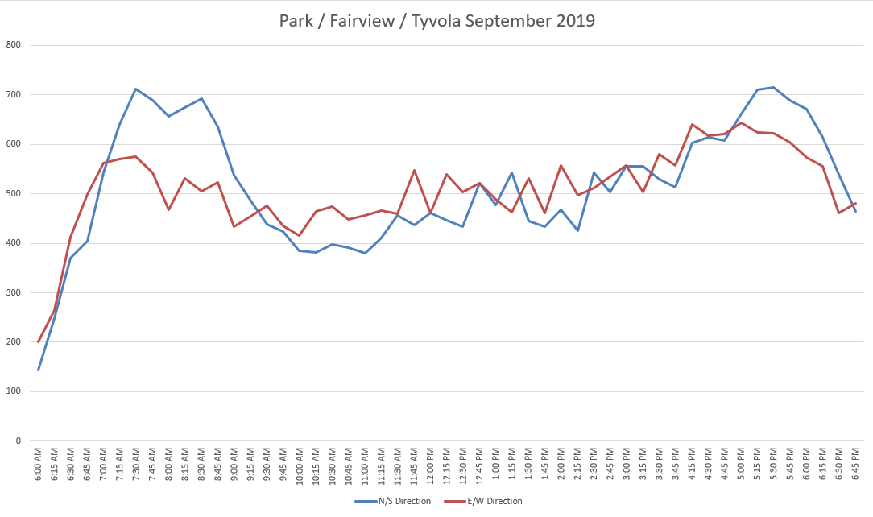
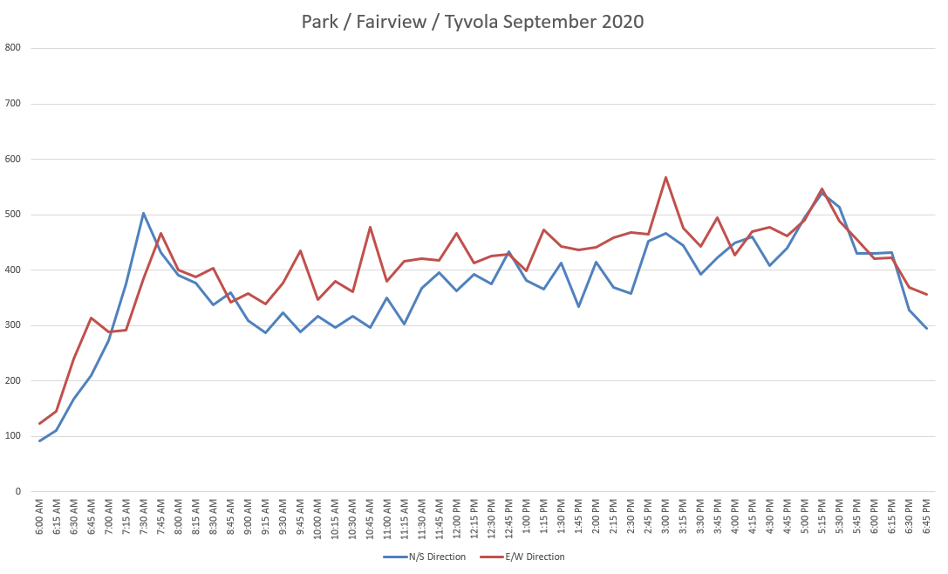
Time-of-Day Shifts (Source: CDOT) Observed spreading of the peak periods, especially AM Implications for peak hour analyses and k-factors!

Slide 20
Implications for Forecasting
How do people get to work?
Drive Alone | 69%
Carpooled | 11%
Public Transportation | 1%
Taxi, Motorcycle, bicycle, walk, etc | 7%
Worked from home | 12%
Source: US Census
Assume vehicle travel will return to pre-COVID conditions?
69%
11%
Possible permanent changes in land use growth and work-at-home
1%
7%
Possible long-term changes in comfort using ridesharing or transit
Source: US Census

Slide 21
Land Use Forecasts Assume slower growth of dense urban employment areas? Candidate for scenario planning

Slide 22
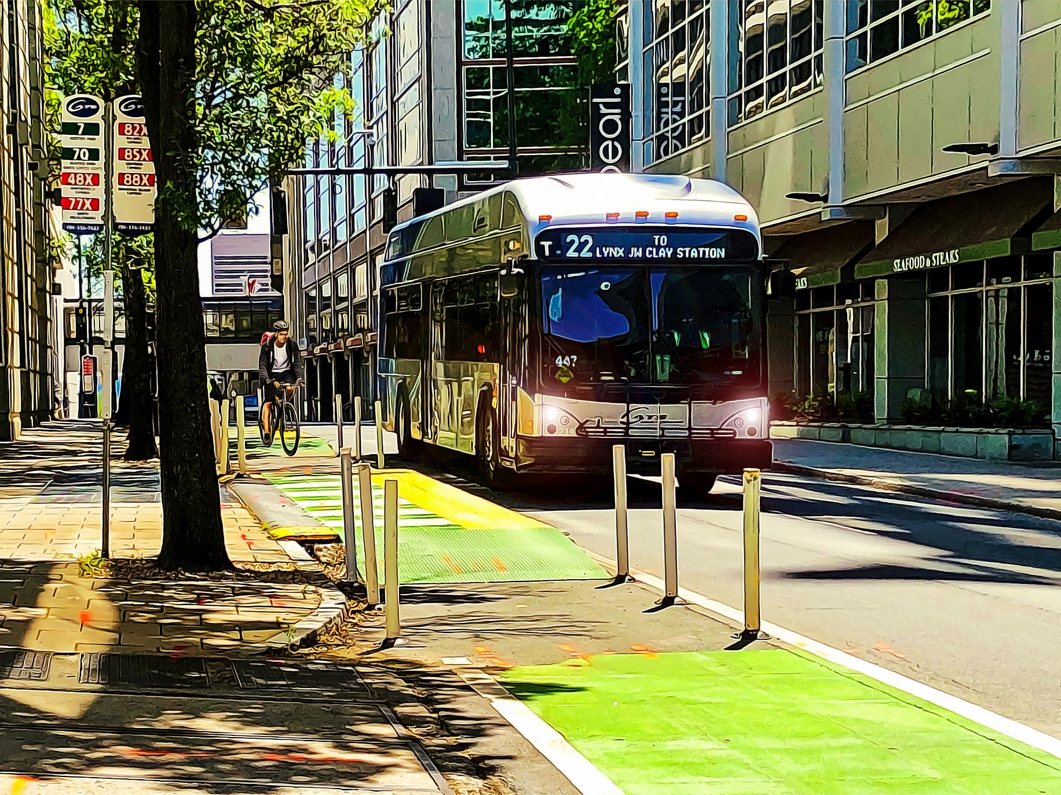
Riding with Other People Consider Markets Transit - Small effects on captive riders - Permanent reduction in comfort for choice riders? Ridesharing - Should be no effect on ridesharing by family - Permanent reduction in comfort for work carpools?

Slide 23
What would we change in our models?
Land Use
We can create alternative scenarios
Mode Choice
COVID impacts are on behavior, not service inputs
Issues like safety embedded in logit constants
Would need to change calibrated constants

Slide 24
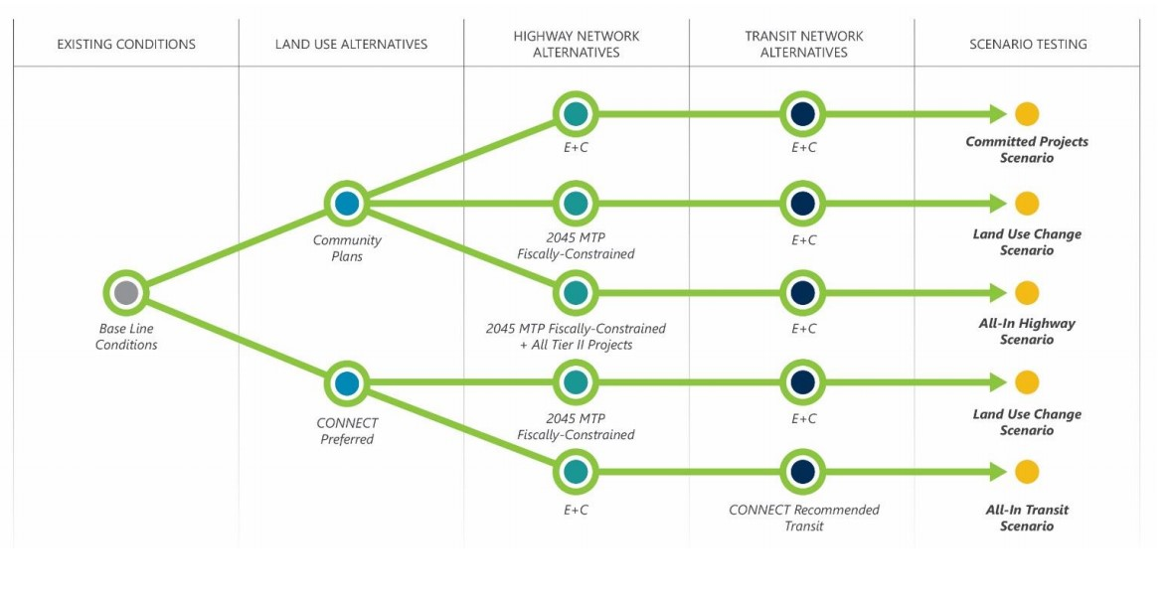
Scenario Planning
How do people get to work?
Drive Alone | 69%
Carpooled | 11%
Public Transportation | 1%
Taxi, Motorcycle, bicycle, walk, etc | 7%
Worked from home | 12%
Source: US Census
Consider alternative futures when specific parameters cannot be calibrated
Most common: single land-use forecast, multiple transportation systems
Source: Charlotte Regional Transportation Planning Organization
Add dimensions for land use, transit/ridesharing comfort, telecommute levels…
Source: US Census

Slide 25
Durham Example 2 land uses 3 transportation systems Can compare each change to base condition

Slide 26
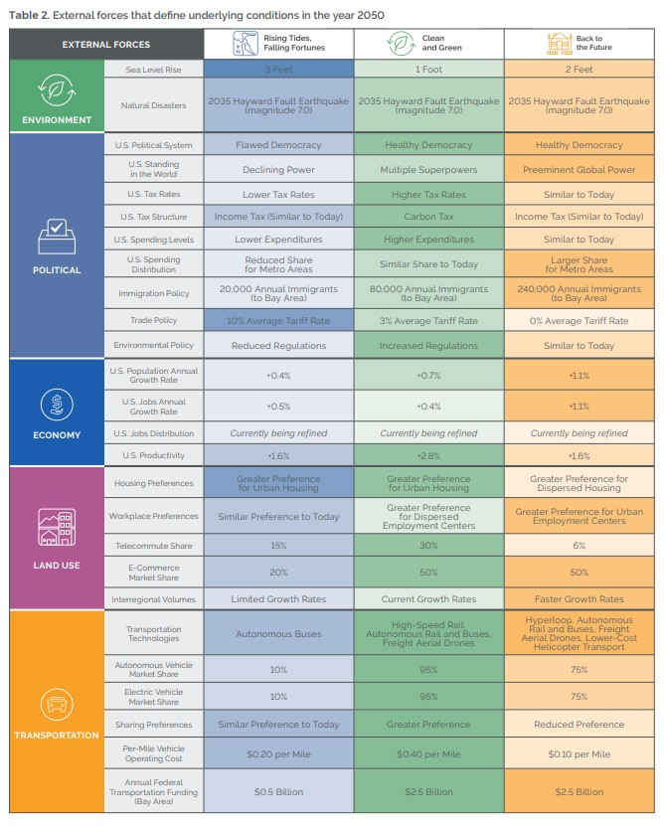
Integrated Scenarios Example from SF Bay Area (MTC) Each scenario has different combinations of growth, pricing, automated vehicles, flooding…. More difficult to isolate impacts of each parameter

Slide 27
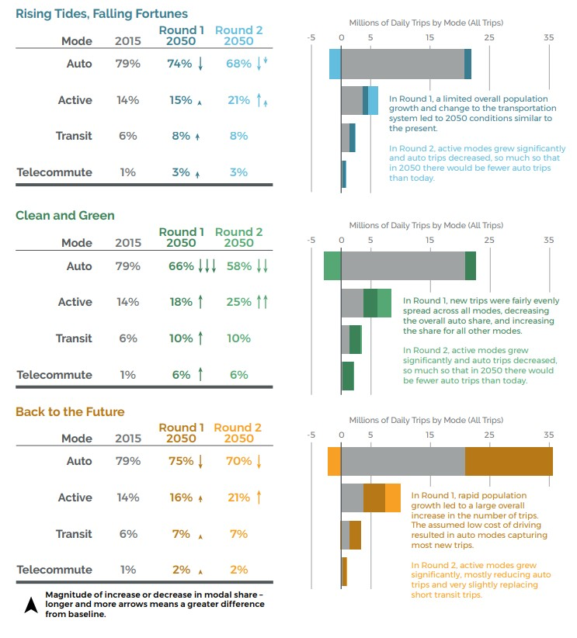
Integrated Scenarios Results 2nd round of analysis implements policies to react to external forces Includes land use modeling (UrbanSim) to reallocate growth based on accessibility

Slide 28
Forecasts After COVID
How do people get to work?
Drive Alone | 69%
Carpooled | 11%
Public Transportation | 1%
Taxi, Motorcycle, bicycle, walk, etc | 7%
Worked from home | 12%
Source: US Census
For traffic forecasting, may be able to assume return to normal (say, by 2030)
For transit forecasts, consider different markets (captive vs. choice)
Scenario planning for uncertainty
Source: US Census

